Slide 1

Designing for Adoption
Moving beyond being right.

Slide 2
CORE QUESTION
What Makes a Solution "Good"?
The Obvious Answer
The Missing Dimension
Analytical quality: thorough diagnosis, sound logic, evidence-based recommendations.
Adoptability separates recommendations that change things from those that gather dust ("credenzaware").
Anticipate how people will experience change, what resistance it will encounter, and what conditions enable success.
This isn't about compromising quality—it's about expanding what quality means.

Slide 3
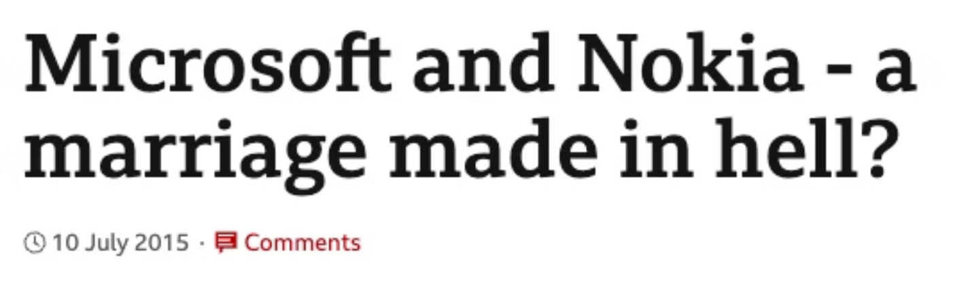

Microsoft's $7 Billion Lesson
September 2013
1
Microsoft announces acquisition of Nokia's mobile phone division for $7.2 billion
2
April 2014
Deal closes with compelling strategic logic: challenge Apple and Google's smartphone duopoly
July 2015
3
What Went Wrong?
Integration struggles become apparent as cultural tensions surface
Correct analysis: Mobile mattered. Nokia had world-class manufacturing and brand recognition.
4
May 2016
BUT: The solution couldn't actually be adopted by the organisations that needed to implement it.
Microsoft writes off nearly entire acquisition, sells remainder for $350 million—a 95% loss
Pursuing the right strategic recommendation can be deathly.

Slide 4

When Cultures Collide
Nokia Culture
Finnish—egalitarian, consensus-driven, flat hierarchies, collaborative decision-making
Microsoft Culture
American—individualistic, competitive, aggressive performance metrics, top-down direction
The Result
Finnish employees found Microsoft's style abrasive. Microsoft employees found Nokia's approach frustratingly slow. Trust eroded, talent left.
These differences were knowable in advance. Culture isn't hidden – but there needs to be an interest in designing a solution for the real organization(s).

Slide 5
Beliefs Matter: A Design Checklist (Armenakis)
Five beliefs that determine whether people support or resist change.
Use these as design criteria before finalising any recommendation (so that you can then build true beliefs).
Discrepancy
Appropriateness
Efficacy
Will people believe change is necessary? If your solution addresses a problem they don't see, you have a design flaw.
Will they believe this is the right change? Even accepting change is needed, they may think your specific solution is wrong.
Will they believe they can actually do it? A technically brilliant solution that exceeds people's capabilities is a fantasy.
Principal Support
Valence
Will they believe leaders are committed? If your solution requires sustained attention from leaders who won't provide it, redesign the solution.
What's in it for them? Self-interest isn't shameful, it's human. If your recommendation makes key people's lives worse, expect resistance.

Slide 6
HOW TO FIND A GOOD SOLUTION?
The Case for Multiple Options
Finding and presenting the single "right" answer seems attractive. But …
01
02
03
Undermines Ownership
Confirmation Bias
Missed Learning
You're telling the client what to do. Even if you're right, the client becomes a critic evaluating your idea rather than a co-creator invested in the solution.
You might be wrong. Once you've identified your preferred option, you'll (unconsciously) filter evidence to support it.
Developing multiple options forces you to articulate trade-offs, surface assumptions, and think through implications you'd otherwise skip.
First diverge: explore possibilities as broadly as feasible. Then converge: evaluate systematically against criteria.

Slide 7





Becoming creative without brainstorming
Brainwriting
Lateral Thinking
Silent idea generation removes social barriers whilst keeping benefits of cross-pollination (cf Paulus and Yang)
Deliberately break patterns. What if we did the opposite? What would a different industry do?
Analogical Reasoning
Constraint Manipulation
How have similar problems been solved elsewhere? What can we borrow?
What if unlimited budget? Zero budget? Deliver in a week? Change the constraints to unlock new thinking.
The goal isn't one creative technique—it's ensuring you've genuinely explored the solution space before narrowing down.

Slide 8
Evaluating Options Systematically: Decision matrices
01
Define Criteria
What does a good solution need to achieve? Hard requirements (cost, timeline, feasibility) and soft ones (cultural fit, stakeholder acceptance, reversibility).
02
Criteria
Weight
Option A
Option B
Weight Criteria
Cost
25%
7/10
9/10
Not everything matters equally. A cheap but culturally impossible solution is worse than an expensive but implementable one.
Timeline
20%
8/10
5/10
Cultural Fit
30%
9/10
6/10
03
Technical Feasibility
15%
6/10
8/10
Score Options
Rate each option against each criterion honestly. Can be helpful to score one criteria rather than one option at a time.
Stakeholder Buy-in
10%
8/10
7/10
Weighted Score
7.75
6.95
04
Examine Results
The matrix doesn't make the decision …. but it enables transparent conversations.

Slide 9

HOW TO DEAL WITH UNCERTAINTY?
Scenario Planning
The Approach
The Critical Question
Identify key uncertainties that would most affect your recommendation
Develop two to four distinct scenarios—not best/worst case, but genuinely different futures
Stress-test your solution against each scenario
Design flexibility where the solution is vulnerable
Not "which future is most likely?" Prediction is usually impossible.
Instead: "How does our solution perform across these different futures? Where is it vulnerable? Can we design in flexibility?"
Sometimes this reveals that a recommendation is too fragile; it only works if specific conditions hold. Better to discover fragility in planning .
Good solutions aren't optimised for one predicted future. They should work reasonably well across multiple possible futures.

Slide 10
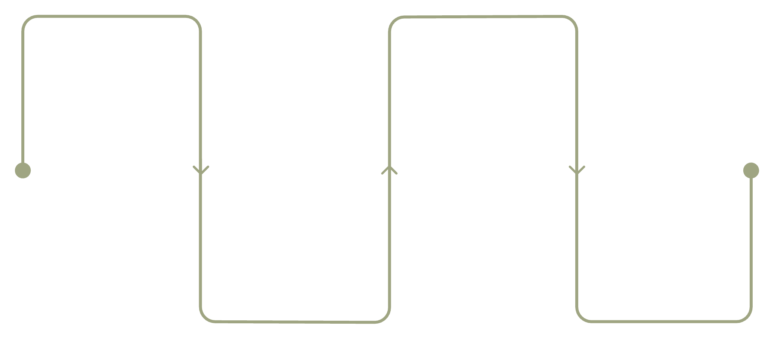
The Pre-Mortem (Klein)
Turn Cognitive Biases Into Advantages
Failure “Made Real”
Vulnerabilities Assessed
Imagine project collapsed
Prioritize risks to address
Hindsight bias makes it easy to explain outcomes, while optimism bias/planning fallacies can blind us to the future
Causes Discovered
Solutions Strengthened
List plausible failure reasons
Implement fixes now
Research shows prospective hindsight—imagining an event has already occurred—increases ability to identify reasons for outcomes by 30%.

Slide 11
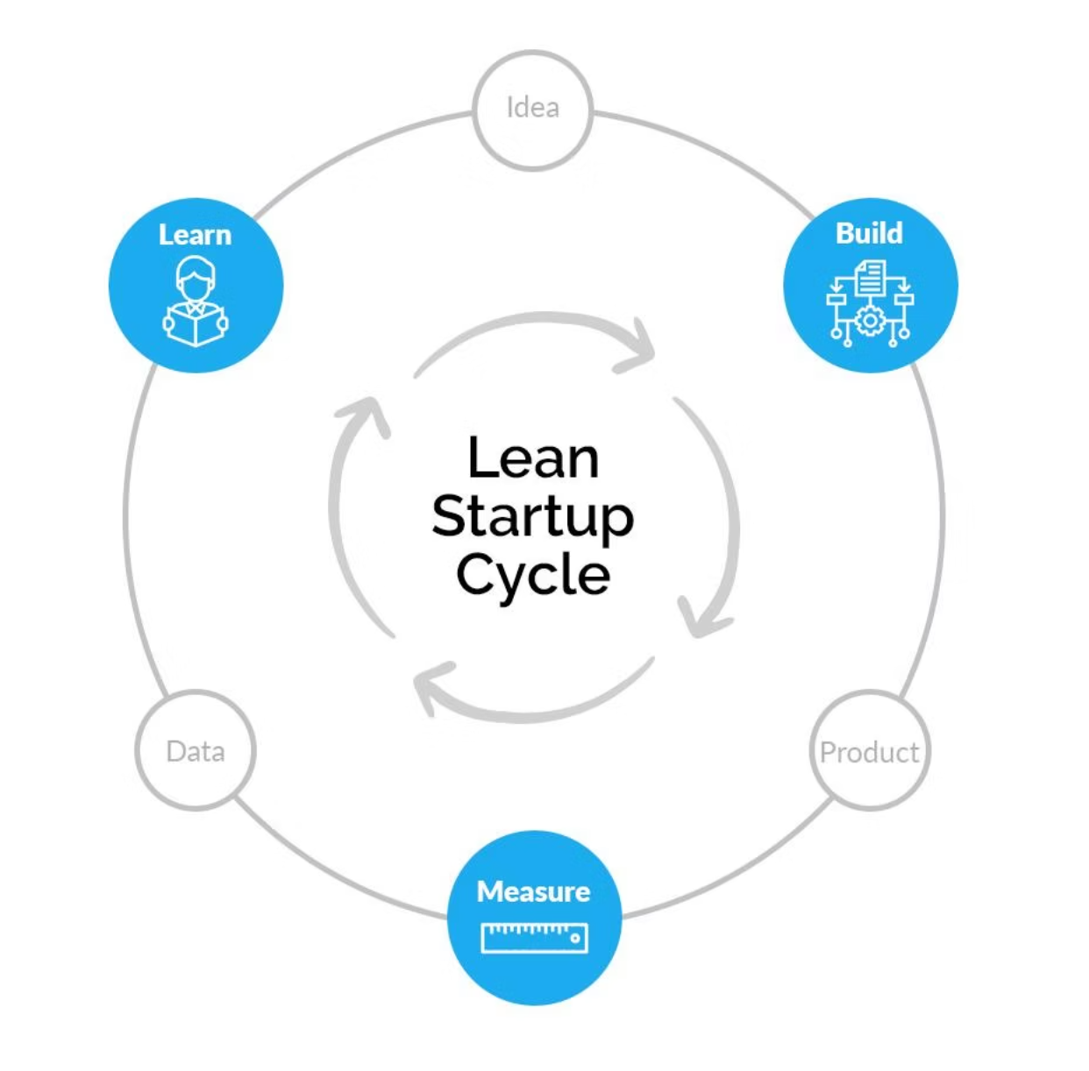

Prototyping and Testing — Including Learning in Design
"Prediction is difficult, especially about the future." (Niels Bohr)
So should we stake all success on a single attempt?
Prototyping and pilot testing reduce risk and build evidence.
A prototype is a rough, quick version designed for learning.
What's the minimum you need to build to test your core assumptions? Can you simulate the solution? Try it in one team? Run a tabletop exercise?
Pilot testing takes this further: implement in one area before rolling out widely.
This generates evidence, surfaces unexpected issues, and creates advocates who've experienced success firsthand.
But think about the purpose and design accordingly.
Solutions designed for learning are more adaptable – and can help build adaptability in the organization.

Slide 12
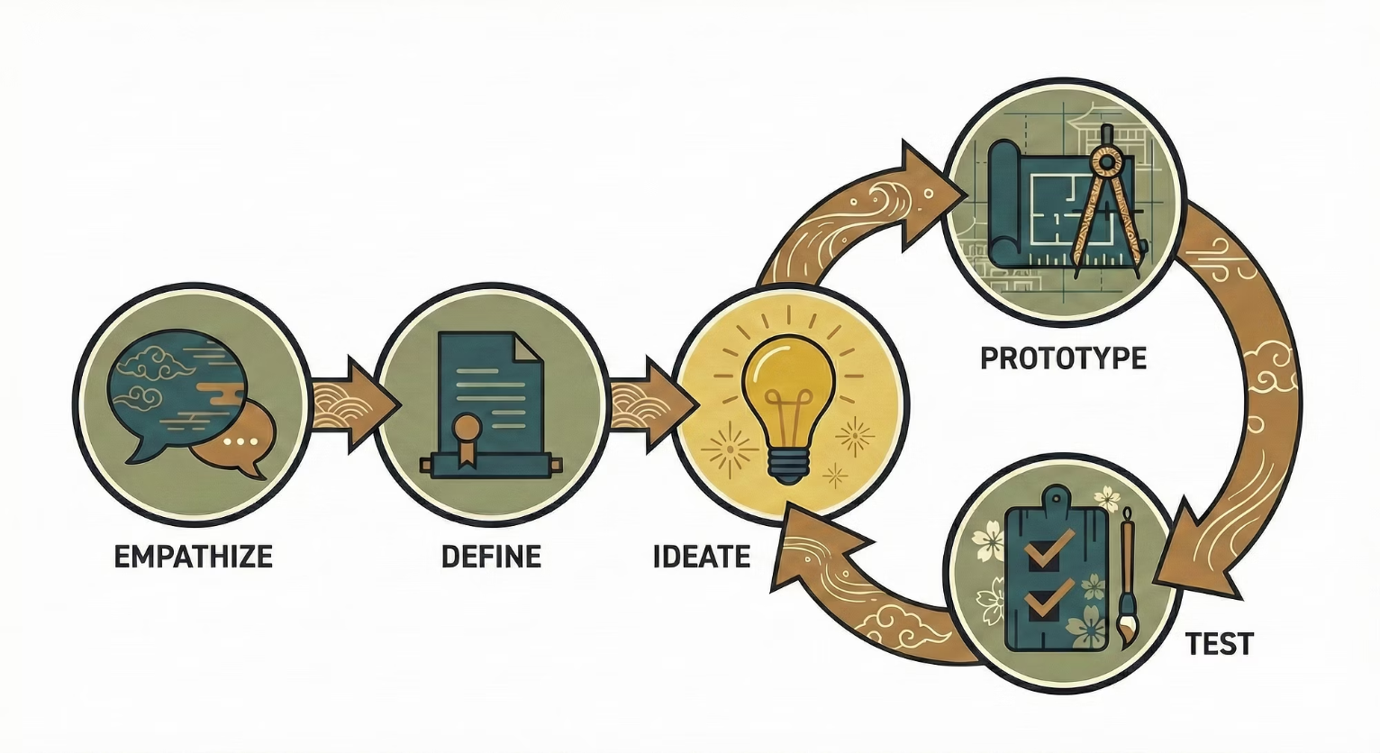

Design Thinking for Consultants
Empathise
Observe and engage with people affected. What matters to them? What frustrates them? What would success look like from their perspective?
Define
Frame the problem clearly. A well-defined problem is half-solved. A poorly-defined problem leads to brilliant solutions to the wrong question.
Ideate
Generate many possible solutions. Quantity before quality. Suspend judgement. Build on others' ideas.
Prototype
Create rough versions quickly. The point isn't perfection—it's learning.
Test
Get feedback from real users. Iterate. Refine. Cycle back repeatedly.
Design thinking is a comprehensive methodology for addressing complex questions — worth reading into.

Slide 13


The Nodding Problem
Even though we all like nodding …
Nodding Isn't Commitment
When stakeholders nod during your presentation, they might be:
Genuinely agreeing
Being polite
Waiting for the meeting to end
Reserving judgement
Quietly planning how to work around your recommendation
So, need to think about what happens afterwards—when people face competing priorities and institutional inertia.
Implementation comes later, but a solution that surfaces concerns early, builds genuine ownership, respects constraints, and anticipates resistance is the first step.
Again: quality of a solution should be about what changes in the organisation, not about sign-off or impressive analytics.

Slide 14
We've explored creativity and designing solutions for adoption. But we also want to get to the right solution - informed by evidence.
Reflection Prompt
Think about a solution—at work or elsewhere—that seemed technically good but failed.
NEXT RECORDING
The Evidence Challenge
What design flaws made it unsuitable for the people and context it was meant to serve?
Next recording: we'll explore the promise and
the pitfalls of evidence-based consulting.

